Slide 1
Employee Data Analysis using Excel
STUDENT NAME: Swetha.V
REGISTER NO: 312220267
DEPARTMENT:III B.COM General
COLLEGE : Jeppiaar college of arts and science

Slide 2
PROJECT TITLE
Employee Attendance Analysis using Excel

Slide 3


AGENDA
Problem Statement
Project Overview
End Users
Our Solution and Proposition
Dataset Description
Modelling Approach
Results and Discussion
Conclusion
3/21/2024 Annual Review

Slide 4

PROBLEM STATEMENT
To Analyse the Attendance Records to know the absenteesim time in hours from the employee attendance data set.

Slide 5

PROJECT OVERVIEW
"Analyzing Employee Absenteeism: This project examines attendance records to identify patterns and trends of absenteeism among employees. Using the employee attendance dataset, we'll calculate absenteeism rates, detect frequent absentees, and investigate underlying reasons. Insights gained will help employers develop strategies to reduce absenteeism and improve workforce productivity."

Slide 6

WHO ARE THE END USERS?
Managing Director
General Manager
Human Resource Manager
Chief Executive Officer
Project Manager

Slide 7

OUR SOLUTION AND ITS VALUE PROPOSITION
Conditional Formatting : To Highlight the Blanks cells and change the font colour of the cell.
Sort & Filter : Delete the Blank space.
Pivot Table : Attendance Analysis through absenteesim in hours.
Formulas : IFS ( To get the Feedback of Rating )
Graphs : ( Area Chart ) : Final Report on Employee Attendance Records.

Slide 8
Dataset Description
Employee Attendance DataSet : Kaggle.com
Features : 33
Reason of Absence : Numerical Values
Month of Absence : Int
Weight : Numerical Value
Height : Numerical Value
Absenteeism time in Hours : Numerical Values
Feedback : Text Values

Slide 9

THE "WOW" IN OUR SOLUTION
New Formula Used : IFS
To find the Attendance Records of Employees by analysing the Absenteeism in Hours.
3/21/2024 Annual Review
9

Slide 10
MODELLING
Data Set Collection – Employee Attendance Dataset
Data Set Preparation – Removing Blanks , Using Filter and Using Conditional Formating.
Using IFS Formula to Attain the record of attendance data.
Insert Pivot table to summarise dataset on employee attendance records.
Data Visualization using Area Chart to represent the Attendance of Employees
Result and Discussion
Final Report
10

Slide 11
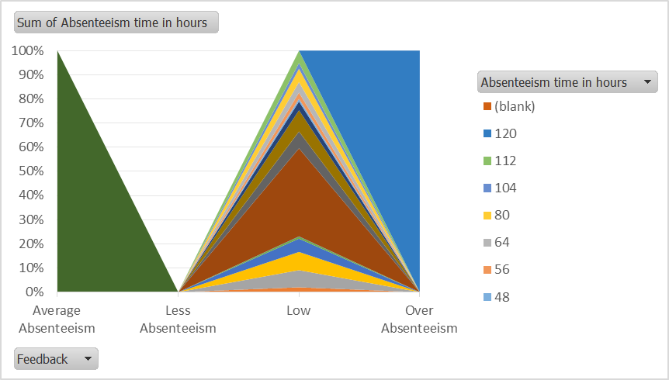
RESULTS
11

Slide 12
Conclusion
"Attendance analysis shows a correlation between absenteeism and job satisfaction. Departments with high absenteeism rates also report lower employee engagement. Implementing targeted interventions, such as recognition programs and employee feedback mechanisms, can help mitigate absenteeism and improve overall workplace culture and productivity."

